Slide 1
Marcus Alert Equity at Intercept 0 Recommendations
Katharine Hawkes, Daryl Fraser, Ryan Banks, sarah Wilson, A’Tasha Christian, Sabrina Burress, Mark Blackwell, Chloe Edwards, Nicky Fadley, Bruce cruser, Eric Blevins, Lisa jobe-shields

Slide 2
Sub-group Members
Katharine Hawkes, MPH-Founder & CEO Isabella Health Foundation, Inc.; Founder HEAL (Health Equity and Literacy), The Print Project; Doctoral Candidate Eastern Virginia Medical School, 2021
Daryl Fraser, MSW-Associate Professor Virginia Commonwealth University
Ms. Ryan Banks, LPC- Director, Behavioral Health Division, Rappahannock Rapidan Community Services
Sarah Wilson, MSW CVA –Assistant Director NAMI Virginia (National Alliance on Mental Illness)
Dr. A’Tasha Christian, LMPH- Director of Operations, Guided Paths, Inc.
Sabrina Burress, MA HS, MA CMHC, Resident in Counseling-Executive Director, ARROW Project

Slide 3
Sub-group Members
Mark Blackwell-Director, Office of Recovery Services Virginia Department of Behavioral Health and Developmental Services (DBHDS)
Chloe Edwards, MPP-Policy Analyst, Voices for Virginia’s Children; Founder, Racial Truth and Reconciliation Virginia
Nicky Fadley-Executive Director, Strength in Peers
Bruce Cruser, MSW-Executive Director, Mental Health America in Virginia
Eric Blevins, CPRS-Comprehensive Harm Reduction Program, Virginia Department of Health
Lisa Jobe-Shields, Ph.D., L.C.P.-Deputy Director, Community Services, Division of Community Behavioral Health

Slide 4
Introduction In the last decade, there have been numerous advances in behavioral health policy; however, problems still plague the behavioral health system as mental illness and substance use persist in the United States. As the nation experiences a reckoning in systemic racism, the need to address persistent, adverse behavioral health outcomes for minority communities has become even more apparent. Through implementation of the Marcus Alert, we aim to provide Virginians equitable, safe, behavioral health responses to their behavioral health crises.

Slide 5
Problem Definition
Behavioral health improvement requires an emphasis on equity and prevention with high focus on a community-based model that initiates care being brought to individuals in need to focus on improved outcomes.
There must be particular focus on equity and safety to ensure the most optimal outcomes, particularly among Black and minority populations which consistently experience adverse outcomes during behavioral health crisis responses.

Slide 6
Problem Definition
It is important to understand the intersection of race and disability status. Those with disabilities have multiple points of contact with the criminal justice system which include arrest, detention, arrest alternatives, diversion, and community supervision.
The pervasive adverse outcomes for people with disabilities, does not exclude race. The risk of arrest is disproportionate across racial/ethnic groups with Blacks with disabilities having highest risk. The risk of arrest is compounded for Black males with disabilities.
Race is a salient factor when examining health inequities which is why Virginia has recognized racism as a public health crisis and is making necessary steps to address the adverse impacts among the Black population.

Slide 7
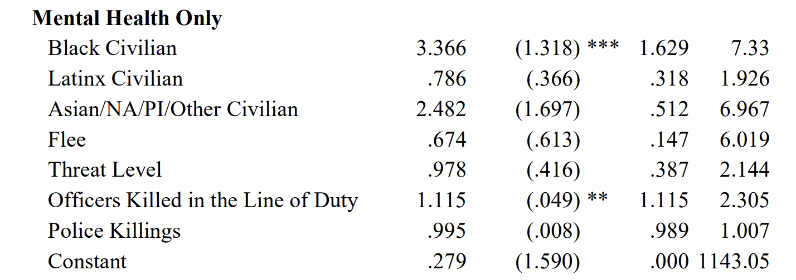
Problem Definition
Risk Ratio Std. Error P 95% CI
Fagan, J. & Campbell, A, 2020. Race and reasonableness in police killings. Boston University Law Review, 100: 951, 2020.

Slide 8
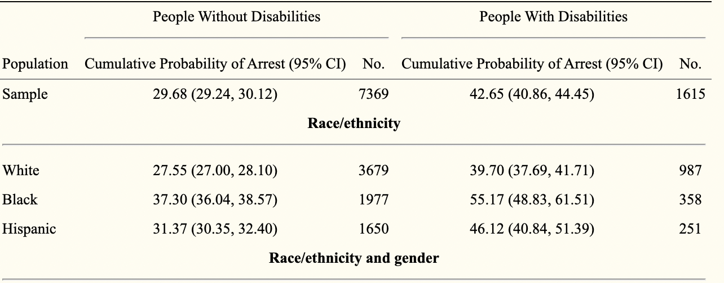
Problem Definition
McCauley, E, 2017. The cumulative probability of arrest by age 28 years in the United States by disability status, race/ethnicity, and gender. American Journal of Public Health, 107(12): 1977-1981.

Slide 9
Plan to Build Support- Initial Equity Implementation Flow Chart
Community Listening Sessions
Community Surveys
Define the problem
Assign State Stakeholder Planning Members
START
Approve Proposal
Integrate into Statewide Framework
Develop a Proposal
Establish Scope and Goals
KEY
Approve Plan
Develop Specific Local Plan
Implement
Assess & Report
DBHDS
Stakeholders Equity Group
Stakeholders Community Group
Regions 1-5
END

Slide 10
Overview of Specific Steps
Leadership
Project Scope
Risks
Roles and Responsibility
Considerations for Multiple Site Implementation

Slide 11
Specific Steps-Leadership
Polycentric Governance
Federal Agencies
States and Cities
Citizens
Academic Institutions
Advocacy Organizations
Companies

Slide 12
How the Innovation Works-Vision
Marcus Alert Equity at Intercept 0
Establish mobile crisis services that commit to do no harm
Increase Safety Supports
Increase Safety through Empowerment
Decrease adverse outcomes from mental health responses
Develop standards for all providers.
Increase equitable access to behavioral health services

Slide 13
How the Innovation Works-Vision Preconditions
Must be based on national best practice models
Must align with the Crisis Now Model which implements collaboration with law enforcement
Must intersect with Step-VA
Must be composed of a crisis call center, community care and mobile crisis teams, crisis stabilization centers, and the Marcus Alert System

Slide 14
How the Innovation Works (vision)-Functionality
Both rural and urban areas must have the ability to frame their local plans to their specific geographic areas and community needs
Functionality will ensure the the Marcus Alert is feasible throughout each region in the Commonwealth, not just the first initial five localities

Slide 15
Specific Steps-Project Scope
Safety
Funding
Training and Quality Improvement
Networks

Slide 16
Specific Steps-Project Scope Training and Quality Improvement
Make recommendations and identify necessary training for all providers (behavioral health, law enforcement, dispatchers, and other first responders) and review (utilizing an equity lens) proposals from other groups that relate to training mental health, law enforcement, and dispatchers
Make recommendations/designate specialized and/or advanced training for all providers (mental health, law enforcement, and dispatchers) and review all proposals from other groups that relate to advanced/specialized training utilizing a mental health and equity lens.
Consider and make recommendations about any special training or certification programs to be developed as part of the Marcus Alert. Identify if a special designation would be helpful.
Make proposals to designate an oversight committee or body to ensure equitable and safe practices at Intercept 0. Identify if a state oversight body, a function of networks, or some other mechanism of ongoing quality improvement in regard to Equity at Intercept 0 should be established.
Make recommendations regarding continuity of care and whether this should be part of the Marcus Alert state plan.

Slide 17
Recommendations- Training and Quality Improvement
Standardized, statewide training for ALL providers (behavioral health, law enforcement, dispatch, other first responders)
Comprehensive approach with a mix of a training program and smaller workshops
Implicit bias, anti-racism, disability justice and cultural competency
Existing training specific to providers is NOT A SUBSTITUTE
MOU for Partner organizations must include the specified standardized training and must produce completion of training

Slide 18
Recommendations- Training and Quality Improvement

Slide 19
Recommendations- Training and Quality Improvement
Paradigm
Evidence-based, data driven, and action-oriented
Interdisciplinary team consisting of organizational psychologists, D&I experts, and data scientists
Consulting services, interactive workshops, and an e-learning program Paradigm_Reach
Diversity benchmarking and reporting
Proprietary algorithms and analytics tools quantify unstructured data and identify trends
Affordable

Slide 20
Recommendations- Training and Quality Improvement
Visions
External survey of clients reported 94% of clients agree diversity and inclusion training excluded their initial expectations
Based on modern racism & reinforces Transactional Theory
Personal Approach to Change and Equity (PACE) Level 1 and 2, youth engagement, internal capacity building, ongoing skill-building, ongoing supervision, & Transactional Analysis (TA)

Slide 21
Recommendations- Training and Quality Improvement
Undoing Racism Workshops (URM), the People’s Institute for Survival and Beyond (PISAB)
Evidence based program with peer-reviewed studies demonstrating improvement in racial attitudes
Undoing internalized racial oppression (inferiority & superiority) and increasing knowledge and awareness of the history and impact of racism, power, privilege, and oppression on community systems
Lived experience of being Black in America
Workshops, consulting, and youth agenda

Slide 22
Recommendations- Training and Quality Improvement
Creating Accessible Neighbourhoods
Canada based but provides workshops in the US
Disability justice, disability awareness, gender & sexuality, and imposter syndrome
Lived experience workshops and consulting services
Well-known for their work in their local community and beyond
Affordable

Slide 23
Recommendations- Training and Quality Improvement
The ARC of Virginia
Grass roots organization with 60 years of experience protecting and promoting the rights of people with developmental disabilities (DD)
Advocacy work is informed by those with disabilities, families and caregivers, and self-advocates
Peer mentoring, Pathways to Justice Training Workshop
Full day
In person
Focuses on identifying barriers to justice

Slide 24
Recommendations- Training and Quality Improvement
Lived experience disability justice advocates that provide consulting and workshop services
Alice Wong, Founder Disability Visibility Project
Imani Barbarin, Founder Crutches and Spice

Slide 25
Recommendations- Training and Quality Improvement
Trauma Resource Institute
Evidence based program with peer-reviewed studies demonstrating statistically significant decreases in the average number of depression, hostility, anxiety, and somatic symptoms; 90% of respondents either completely or somewhat agreed that CRM skills were useful; 98% reported being moderately to very satisfied with TRM training
Trauma Resiliency Model (Level 1 &2), Community Resiliency Model
Affordable

Slide 26
Recommendations- Training and Quality Improvement
De-escalation Training
Crisis De-escalation Training by The White Bird Clinic, Cahoots
Based on a client-centered model upholding personal autonomy
Uses approaches so a lay-person can maintain personal safety and recognize when others may need help
Has been offered to a range of organizations including governmental, community, and EMS groups

Slide 27
Recommendations- Training and Quality Improvement
Continuity of Care

Slide 28
Recommendations- Training and Quality Improvement
Establish a sense of patient autonomy and dignity at all times
This includes release of body-camera footage, blurring identity of individuals to protect their privacy
Crisis teams must provide language access, adaptive approach but must specify

Slide 29
Specific Steps-Project Scope Funding
Review Medicaid criteria for mobile crisis teams for Dec 1. Identify concerns or issues and ideas for mitigation.
Make recommendations for requests for proposals that would support the network and coalition described in 11, as well as making recommendations for other requests for proposals such as start-up funds for crisis providers.

Slide 30
Recommendations- Funding
Funding
Staff
Equipment
Training

Slide 31
Recommendations- Funding (Overall Funding)
The overall Marcus Alert Budget consists of the following: call center staff $4.7 million (STEP VA) (790); adult mobile crisis $6.1 million (STEP VA) (790); $3 million for teams/Marcus Alerts ($600,000 for each region) (790); 1 FTE at Central Office for Marcus Alert implementation (720); and 1 FTE at the Virginia Department of Criminal Justice Services (DCJS) for Marcus Alert implementation

Slide 32
Recommendations- Funding (Equity & Safety @ Intercept 0)
Start-up funds budget is $600,000 with eight $75,000 packages.
Specific funding for five organizations/sites totaling $1,050,000 with seven $150,000 packages.
Specified community outreach budget which totals $25,000.

Slide 33
Recommendations- Funding (Staffing Long-term Resource)
Two .5 FTE internships, $20,000 each position with possible fringe benefits. The positions will entail one community/network facing position and one research/data facing position.
One FTE peer position or two .5 FTE peer positions totaling $50,000 plus fringe = $65,000
One .5 FTE academic or non-profit staff (can also be donated in-kind) = $30,000

Slide 34
Recommendations- Funding (Short & Long-term Resources)
Training
Laptops
GPS enabled tablets
Smartphones
Vehicles (either re-purposed or new)
Software to track training and other metrics.

Slide 35
Specific Steps-Project Scope Safety
Make recommendations for Marcus Alert teams that are NOT mobile crisis (community care teams without law enforcement and community care teams with law enforcement).
Examine recommendations from other groups in regard to community care teams involving law enforcement, to identify other options for safety supports.
Assist with defining best safety practices to mitigate risks including, but not limited to, a no-force first approach, both in terms of intercept 0 as well as responding to other group proposals at intercept 0/1 or 1.

Slide 36
Recommendations- Safety
Co-Response must include no force, non-lethal and unobstructed, body-worn cameras for all LE that must be turned on at arrival
A list of specific strategies to slow down interactions when LE arrives on scene
Clinician on phone or via telehealth with LE so LE can approach but is accompanied by the clinician via iPad
Mental health support on phone with clinician and clinician can contact LE if approach needed

Slide 37
Recommendations- Safety
Crisis responders must involve natural supports to aid in de-escalation
Establish a specific level of care screening for ALL to follow
Even during co-response, LE should have allowances to leave the scene so MH may conclude services and provide resources
Recognize crisis providers must be incentivized to handle their own work-related stress and trauma
Specific protocols for first contact, particularly in rural areas when one provider arrives on scene prior to the other (e.g. LE arrives prior to MH)
State should mandate written procedures be created and available to the public
Adaptive not prescriptive

Slide 38
Specific Steps-Project Scope Networks
Describe how to establish a relationship between CSBs and private providers with a particular focus on providers of color to reinforce equitable, patient-centered care, and to ensure that are contracting relationships and community providers who represent the areas they are serving. This may include the development of a sample MOU between a private provider and the regional crisis hub.
Make a recommendation and outline for networks and/or a Coalition with a racial and social justice lens and a strong interest in the success of the Marcus Alert, while working with DBHDS to estimate budgetary needs for such a network and how this network would work with CSBs, private providers, and students/researchers.
Make recommendations for requests for proposals that would support the network and coalition described above, as well as making recommendations for other requests for proposals such as start-up funds for crisis providers.

Slide 39
Recommendations- Networks
Networks
Coalitions

Slide 40
Recommendations Networks
Partner organizations’ initial application during call for proposals must include their equity lens and anti-racist statement.
Infrastructure will consist of 6-8 sites/groups/network leads and must be specifically defined.
Must be a combination of disruptive and cooperative with representation in social work, psychology, human services, ethics, and justice orientation
Must have rural coverage as much as possible to eliminate non-equitable coverage favoring urban areas

Slide 41
Recommendations Networks
One site must have a relationship with each mobile crisis hub
Must be clinical or have a close connection to a clinical agency that bills Medicaid or is a training clinic with licensed supervision
Must have a relationship/participate in dispatch infrastructure with mobile crisis hubs
All sites must be collaborative meeting with regularity (e.g. quarterly meetings and annual conference)

Slide 42
Recommendations- Coalition
DBHDS
State Stakeholder Committee
Region 1:
Rappahannock-Rapidan Community Services
Region 2:
Prince William County Community Services
Region 3:
Highlands CSB
DCJS
Region 4:
Richmond Behavioral Health Authority
Region 5:
Virginia Beach Human Services

Slide 43
Recommendations- Coalition
Black-led Coalition
Seat on the Oversight Committee
Will be independent oversight for Intercept 0 ensuring equitable practices
Board-like formation

Slide 44
Specific Steps-Risks
There is severe risk of harm if equity and safety are not achieved at Intercept 0.
Society has a rampant history of unjust social structures and people with mental illness and/or disability are among the most marginalized, stigmatized populations.
When factoring in race, risks are exponentially increased with Black and minority populations experiencing significantly increased adverse outcomes as a result of crisis intervention.

Slide 45
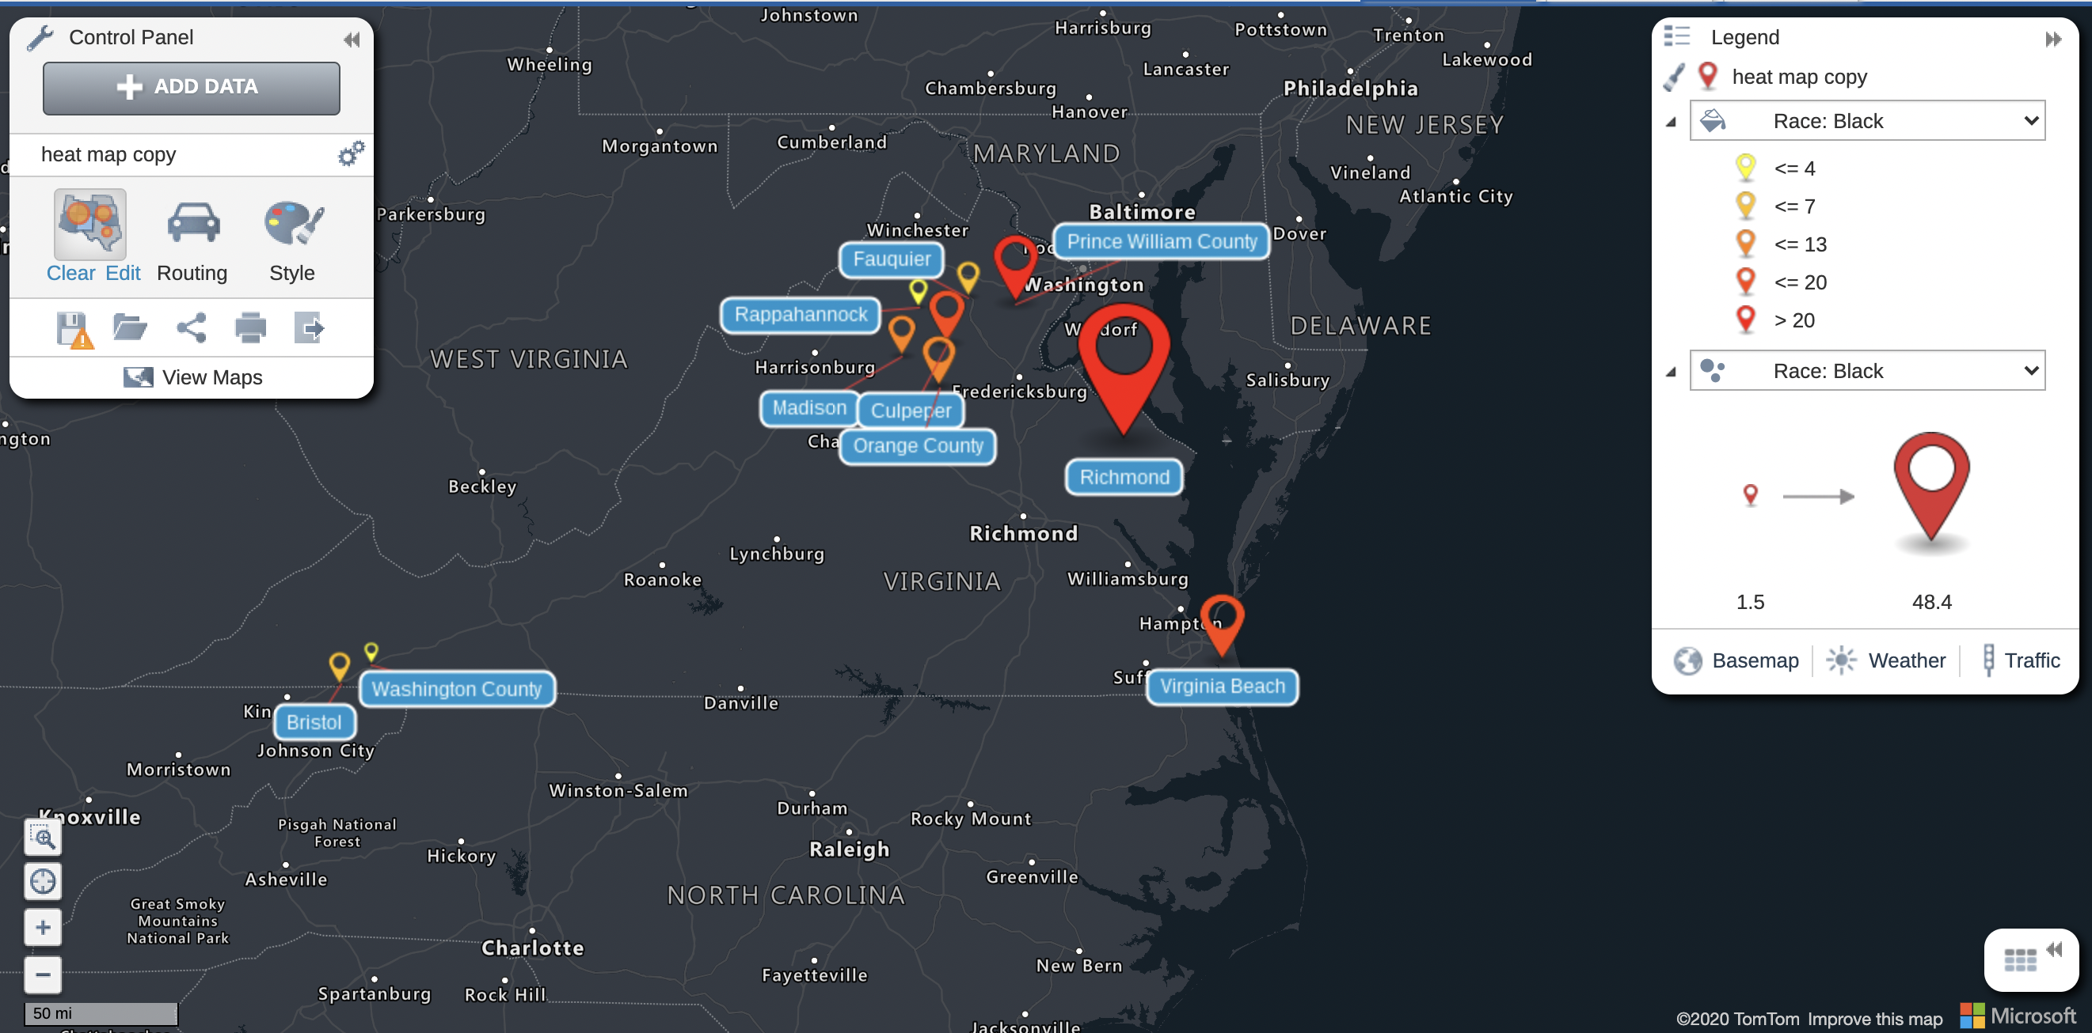
Specific Steps-Risks

Slide 46
Specific Steps-Considerations for Multiple Site Implementation
Region 1:
Orange, Madison, Culpeper, Fauquier & Rappahannock Counties
Region 2:
Prince William County
Region 3:
City of Bristol and Washington County
Region 4:
City of Richmond
Region 5:
Virginia Beach

Slide 47
Assessment Plan
DBHDS
DCJS

Slide 48
Assessment Plan
Number and description of approved local programs and how the programs interface comprehensive crisis system and mobile crisis response
Number of crisis incidents and injuries to any parties involved; a description of successes and problems encountered
Analysis of the overall operation of any local protocols or programs, including any disparities in response and outcomes by race and ethnicity of individuals experiencing a behavioral health crisis, and recommendations for improvement of the programs
Results from the assessment and written report will aid in development of additional sites

Slide 49
Assessment Plan

Slide 50
Conclusion
Eliminate the de facto law enforcement response to a behavioral health response for behavioral health crises.
Data should confirm there are decreased adverse outcomes in racial/ethnic communities and less barriers to accessing care.

Slide 51
References
Abramovitz, M., & Blitz, L. V. (2015). Moving toward racial equity: The undoing racism workshop and organizational change. Race and Social Problems, 7(2), 97-110.
Algeria, M., Frank, R., Hansen, H., Sharfstein, J., Shim, R., & Tierney, M., 2021. Transforming mental health and addiction services. Health Affairs, 40(2).
Arc Virginia, 2021. What we do. Retrieved from https://www.thearcofva.org/home.
Dixon & Patel, 2020. The application of implementation science to community mental health. Journal of World Psychiatry, 19(2):173-174.
Community Healthcare Coalition of Greater Prince William County, 2019. Greater Prince William community health assessment. Retrieved from http://www.behealthybehappyprincewilliam.com/content/sites/princewilliam/Greater_Prince_William_Community_Health_Assessment_2019_Report_6.pdf

Slide 52
References
Community Health Solutions, 2020. A community health needs assessment prepared for health planning district 9. Retrieved from https://www.vdh.virginia.gov/content/uploads/sites/127/2020/10/PD9-CHNA-Report_FINAL-Delivered-9.30.20.pdf
Creating Accessible Neighbourhoods, 2021. Disability Justice. Retrieved from https://www.canbc.org/workshops/disability-justice/
Crutches and Spice, 2021. We need to talk about ableism related anxiety. Retrieved from https://crutchesandspice.com/2019/11/09/we-need-to-talk-about-ableism-related-anxiety/
Disability Visibility Project, 2021. About us. Retrieved from https://disabilityvisibilityproject.com/about/#:~:text=Alice%20Wong%20(she%2Fher),and%20culture%20created%20in%202014.

Slide 53
References
Dixon & Patel, 2020. The application of implementation science to community mental health. Journal of World Psychiatry, 19(2):173-174.
Fagan, J. & Campbell, A, 2020. Race and reasonableness in police killings. Boston University Law Review, 100: 951, 2020.
Hamilton-Mason, J., & Schneider, S. (2018). Antiracism expanding social work education: A qualitative analysis of the undoing racism workshop experience. Journal of social work education, 54(2), 337-348.
McCauley, E, 2017. The cumulative probability of arrest by age 28 years in the United States by disability status, race/ethnicity, and gender. American Journal of Public Health, 107(12): 1977-1981.
Paradigm, 2021. Comprehensive Solutions. Retrieved from https://www.paradigmiq.com/.

Slide 54
References
People Inc. Community Assessment, 2017. 2017 community assessment. Retrieved from https://www.peopleinc.net/media/About/Publications/Publications-PINC-%20Community%20Assessment%202017.pdf
Roberts, A., 2005. Crisis intervention handbook, 3rd edition assessment, treatment, and research. Oxford University Press.
Substance Abuse and Mental Health Association, 2020. National guidelines for behavioral health crisis care, best practices toolkit. Retrieved from https://www.samhsa.gov/sites/default/files/national-guidelines-for-behavioral-health-crisis-care-02242020.pdf
Trauma Resource Institute, 2021. Research. Retrieved from https://www.traumaresourceinstitute.com/research

Slide 55
References
Virginia Beach Department of Public Health, 2019. Virginia Beach Department of Public Health 2019 community health assessment. Retrieved from https://www.vdh.virginia.gov/content/uploads/sites/131/2019/06/VBDPH_CHA_2019.pdf
Virginia Department of Behavioral Health & Developmental Services, 2021. The Marcus-David Peters Act. Retrieved from https://dbhds.virginia.gov/human-resource-development-and-management/health-equity/mdpa
Virginia Department of Health, 2017. Community health assessment, Richmond city 2017. Retrieved from https://www.vdh.virginia.gov/content/uploads/sites/119/2017/09/RCHD-CHA-Aug-2017.pdf

Slide 56
References
Virginia Division of Legislative Services, 2020. Behavioral health redesign, a proposal to advance proactive, evidence-based solutions. Retrieved from http://dls.virginia.gov/groups/MHS/pocketguide.pdf
Visions, 2021. Diversity, equity and inclusion. Retrieved from https://www.visions-inc.org.
White Bird Clinic, 2021. Crisis de-escalation training. Retrieved from https://www.traumaresourceinstitute.com/research.

